Slide 1
Magic Of Micro-Controller
An Intensive Training Course on Micro-Controller
Brought To You By TechShopBD.Com

Slide 2
Topics
Micro-Controllers
Introduction to MCU
Fundamental Architecture of MCU
Types of AVR Micro-Controller
Pin-Diagram of ATmega32 MCU
AVR Programmers
Programming with ATmega32 MCU

Slide 3
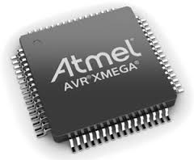
Introduction To MCU
A microcontroller (or MCU) is a small computer on a single integrated circuit. In modern terminology, it is a System on a chip. A microcontroller contains one or more CPUs (processor cores) along with memory and programmable input/output peripherals.

Slide 4
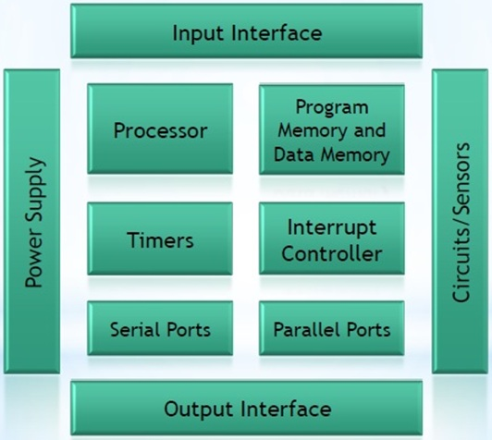
Fundamental Architecture of MCU

Slide 5
Types Of Micro-Controller
8051 (Since 1985)
AVR
PIC
ARM

Slide 6
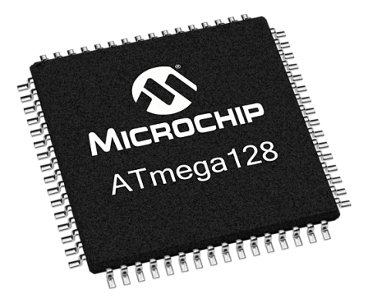
AVR Micro-Controllers
AVR microcontrollers’ architecture was developed by Alf-Egil Bogen and Vegard Wollan. The name AVR is derived from the names of the architecture developers of the microcontroller.

Slide 7
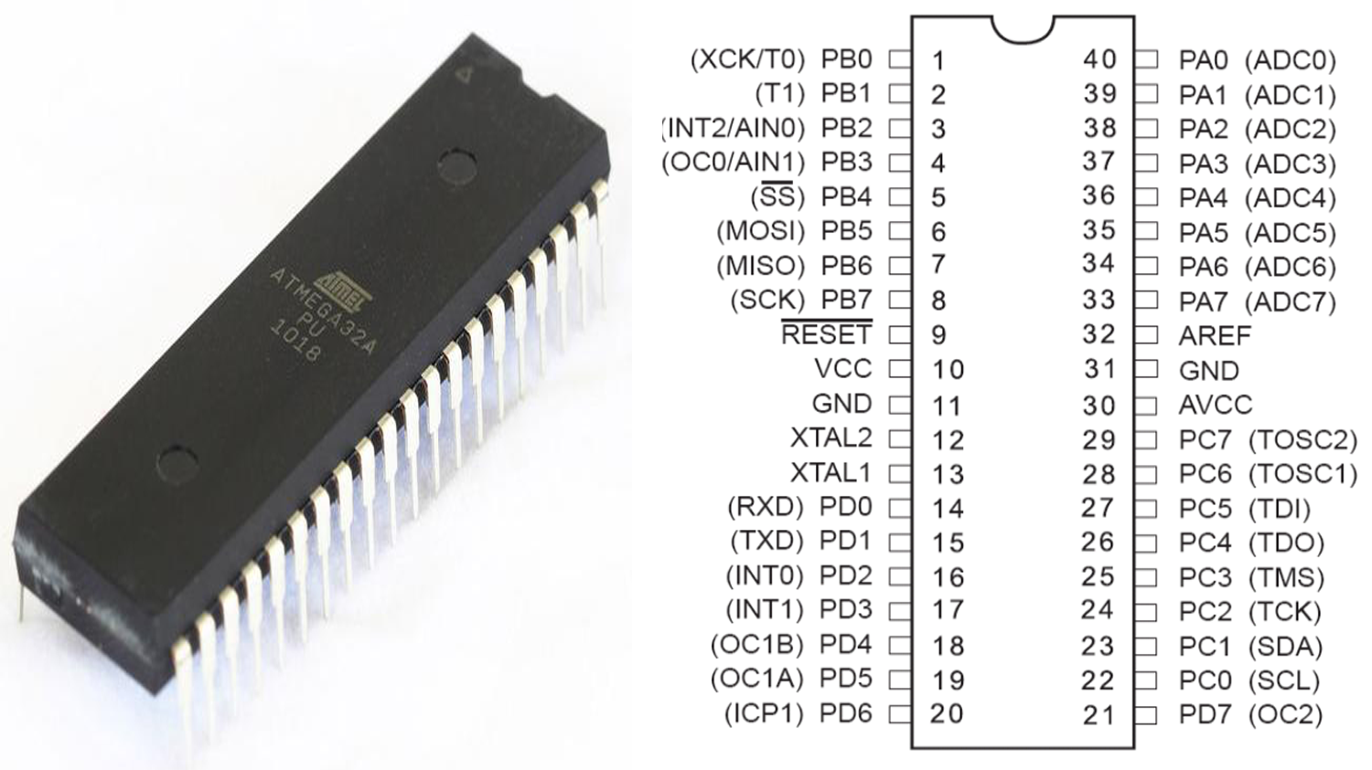
Pin-Diagram Of ATmega32

Slide 8
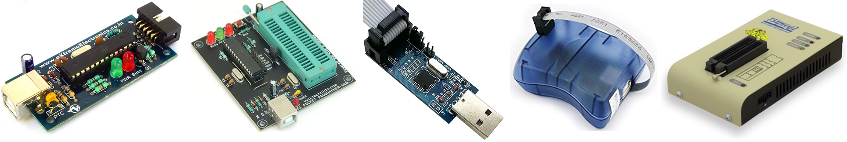
AVR Programmers
The AVR Programmer plugs directly into your computer USB port and provides a programming socket for the avr micro-controller.

Slide 9
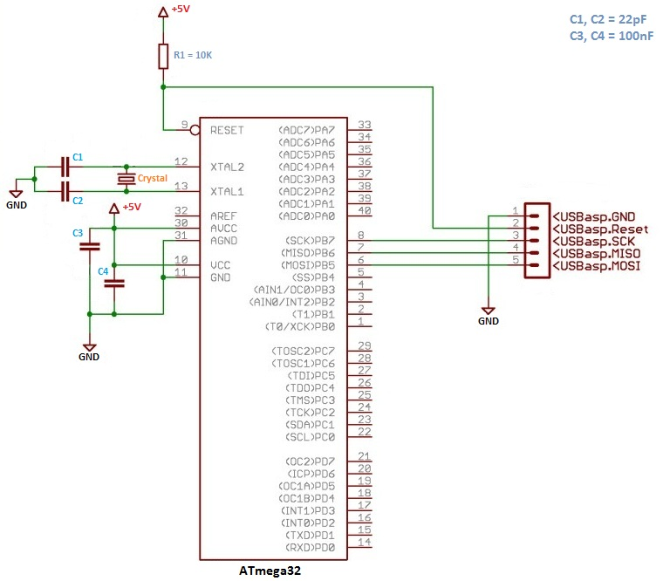
Programming with ATmega32

Slide 10


Slide 11
Thank You

